Slide 1
SOFTWARE ENGINEERING PROJECT BASED ON THE COURSE CSE 402 RICH FORMATTED TEXT EDITING APPLICATION

Slide 2

PRESENTED BY: SADIA ISLAM SAMI Roll: 16102018 Reg id: 4870
PROJECT PARTNER: ASHIKUZZAMAN ROLL: 16102020 REG ID: 4872

Slide 3
OUTLINE
Introduction
Improvements
Technical terms
Time scheduling
Demonstration
FAQ

Slide 4
INTRODUCTION
It supports multiple font styles, font size and paragraph text alignment etc.
Basic cut, copy and paste features are available with easy access.
There is also support for drag-drop of images which are automatically opened and embedded.
Generate doc, txt, html formats easily.
The most important thing is that it easily generate a basic webpage without coding.

Slide 5
IMPROVENMENTS
Rich text editing section.
Free to use.
Easy use on lower configuration devices.
Open source.
Not dependent on internet connections.
Drag and drop image addition.
Multiple file formatting: doc, txt, html etc.
Basic webpage creation without coding knowledge.
Works without internet.

Slide 6
TECHNICAL TERMS
To design an environment of simple formatted text editor application.
To learn python programming.
To design and develop the GUI section with PyQt5.
To create Python bindings for C and C++ libraries with SIP.
To integrate the overall system on PyChram (IDE).

Slide 7
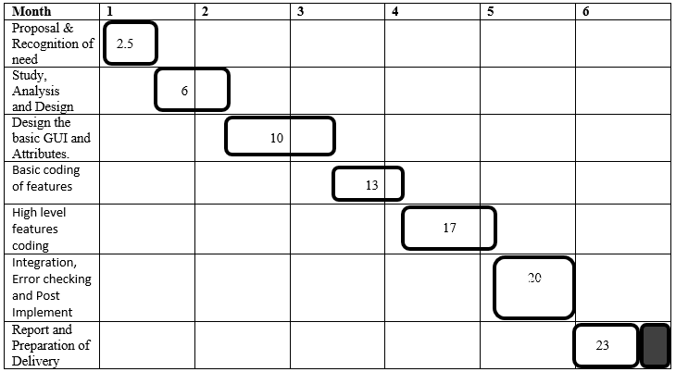

TIME SCHEDULING

Slide 8
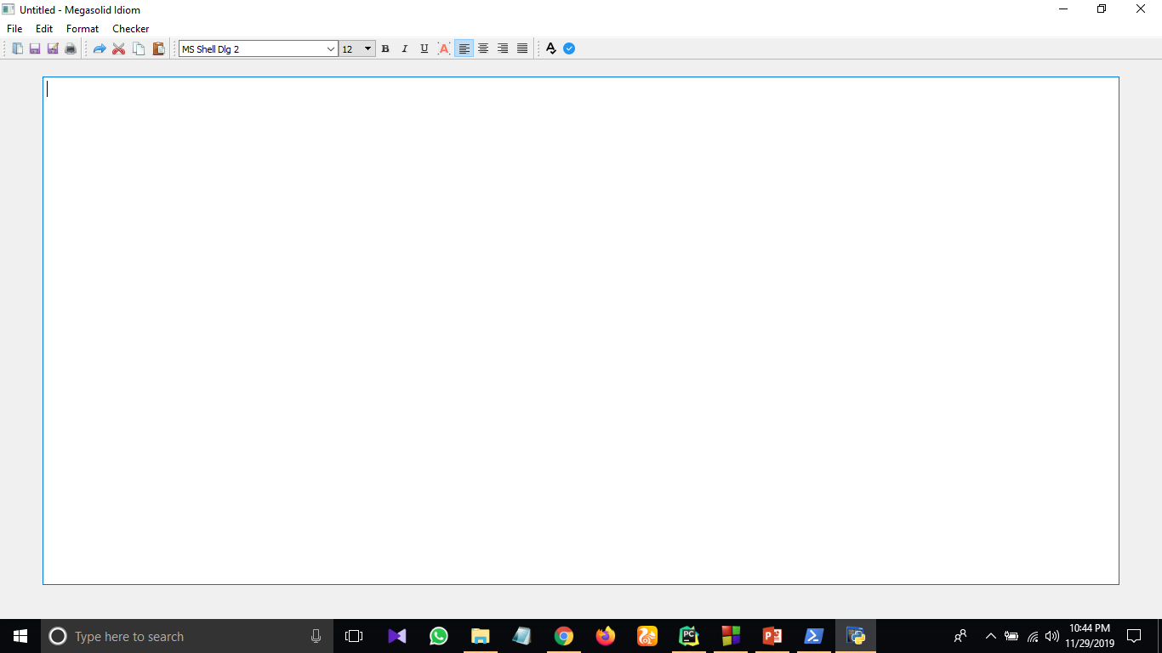
DEMONASTRATION
Outer look

Slide 9
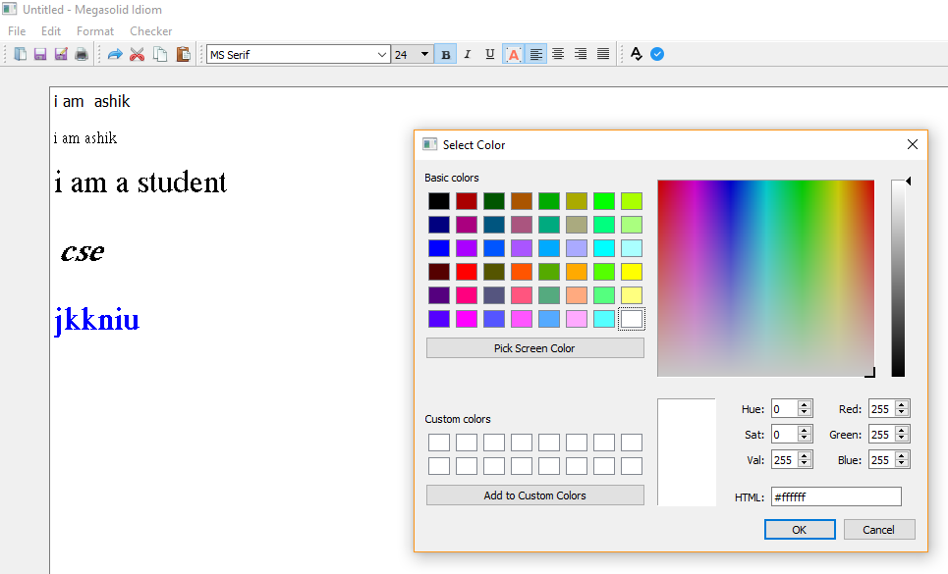
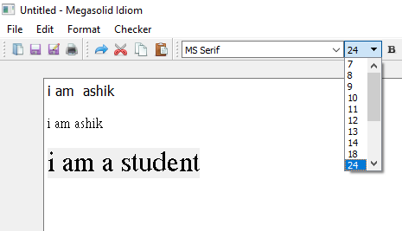
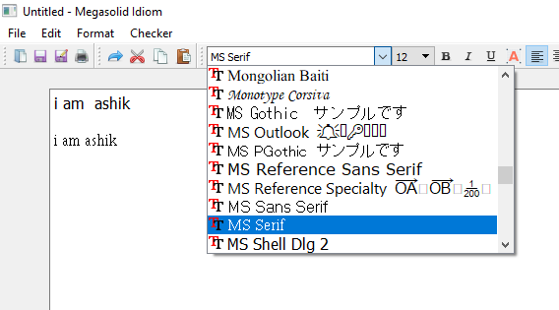
Text
color
changing
Text Size & Font changing

Slide 10
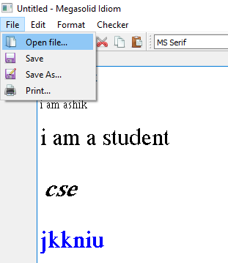
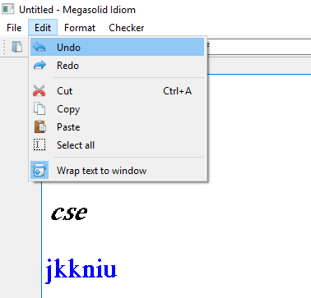
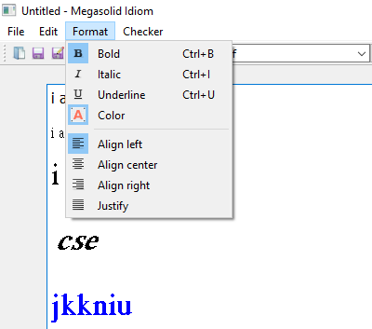
File & Edit menu
Format menu

Slide 11
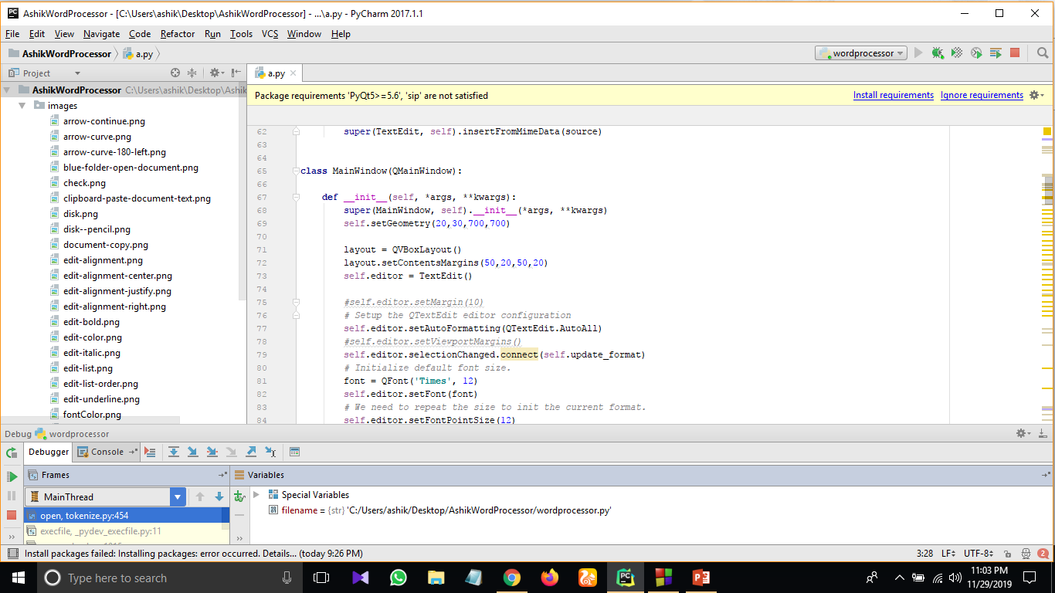
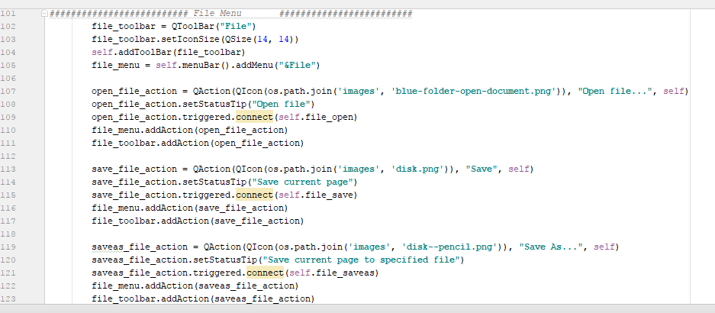
Main window
File
menu

Slide 12
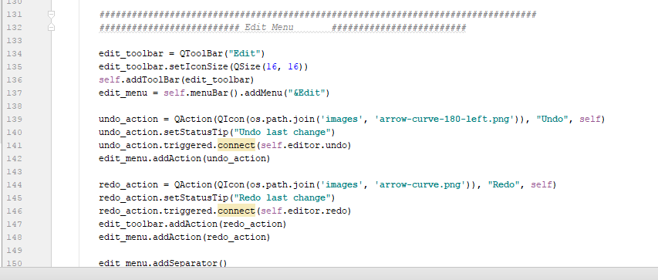
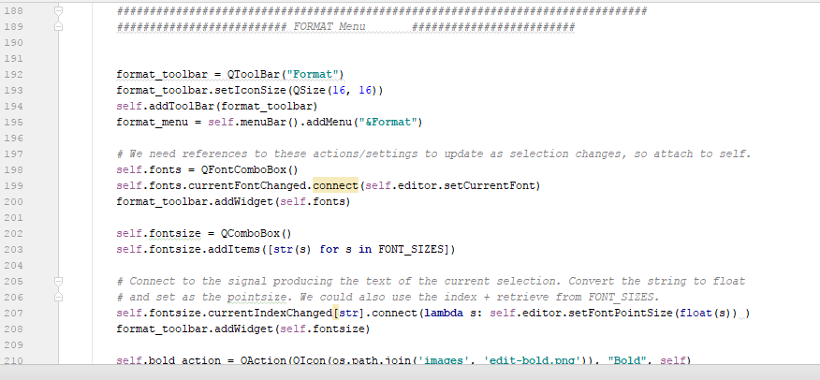
Edit menu
Format menu

Slide 13
FAQ ???
Thank you

